Slide 1
Jermyn Borough Council Meeting
12/21/2023

Slide 2
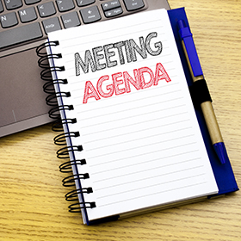
Meeting Agenda
December 21 ,2023
CALL TO ORDER
PLEDGE OF ALLEGIANCE
ROLL CALL
PREVIOUS MEETING MINUTES
TREASURER REPORT/BILLS PAYABLE
SECRETARY REPORT
CORRESPONDENCE
PUBLIC COMMMENT
PROFESSIONAL REPORTS
COMMITTEE REPORTS
2024 BUDGET ADOPTION
2024 TAX RATE RESOLUTION
2024 GARBAGE RATE RESOLUTION
AUDITOR AGREEMENT
ESTABLISH 2024 MEETING DATES
DPW GARAGE ELECTRICITY INSTALLATION
NEW BUSINESS

Slide 3
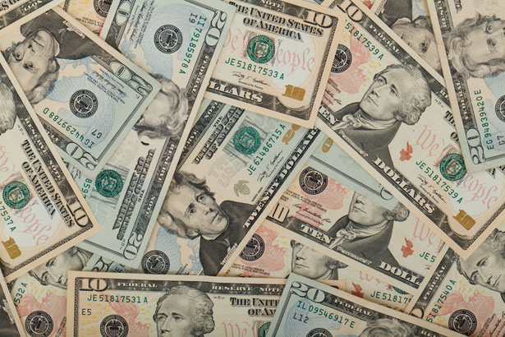
Treasurer’s report
12/21/2023
ASSETS
Checking/Savings
American Rescue Plan Fund 135,737.20
Capital Reserve - DPW 729.48
Capital Reserve - Police 5,369.82
Crime Watch Fund 222.69
General Fund - Community 87,186.80
General Fund - FNB 6,793.81
Holiday Lights Fund 1,459.09

Slide 4
Treasurer’s report
Investment - General Fund 1,059.54
Investment - Liquid Fuels 23,329.00
Investment - Paving Fund 1,070.57
Investment - Recycling 117.02
Investment - Refuse 166.86
Liquid Fuels - FNB 13,646.60
Petty Cash 223.00
Recreations Fund 27,902.27
Recycling - Community 3,364.59
Refuse Checking - FNB 61,274.01
Total Checking/Savings 369,652.35

Slide 5
Treasurer’s report
200000 · Accounts Payable 12,229.76
Long Term Debt 160,467.75

Slide 6


